Slide 1



Underwater ERT method to image karst cavity distribution below the river water
Daopu Wang¹* Haibin Chai² Dikun Yang¹ Banglia Lv²
1. Southern University of Science and Technology, Shenzhen, Guangdong, China
2. 2. CCCC-FHDI Engineering Co., Ltd., Canton, Guangdong, China
2023.10.18
Gravity, Electrical, Magnetic and Electromagnetic Research at SUSTech

Slide 2


Outline
01
Introduction
02
Surveys
03
Methods
04
Results
05
Conclusions

Slide 3
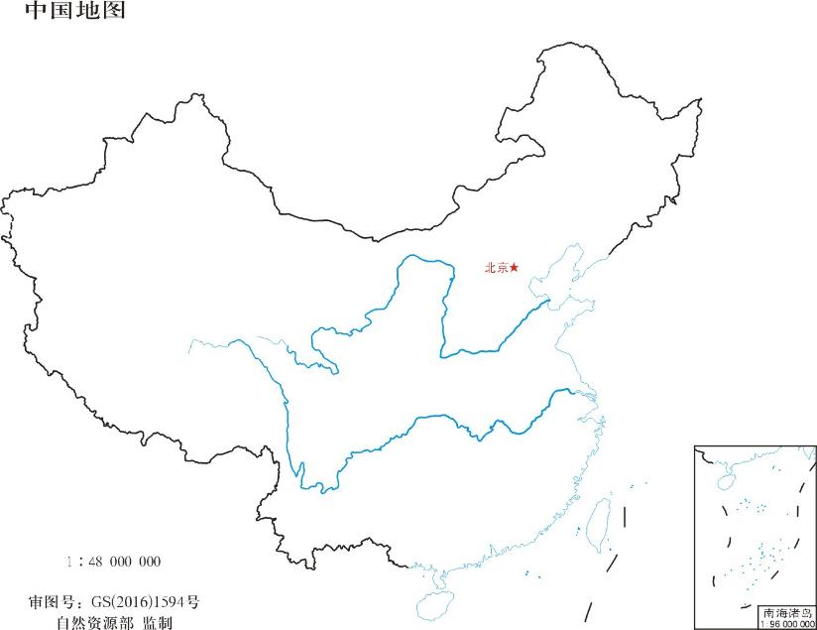
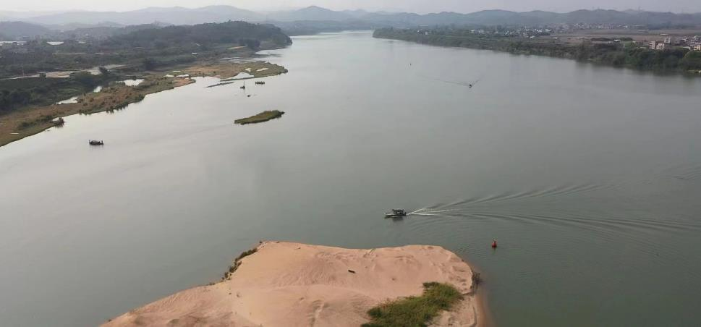
01
Introduction
Dong River
dam
dam
River Info
River Depth | 0.5 — 9m
River Width | Above 700m
Rock Type | silt, weathered limestone, pulverized clay, shale, sandstone …
(Huizhou, China)

Slide 4
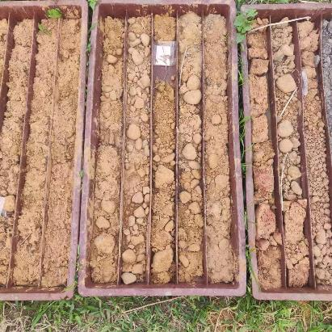
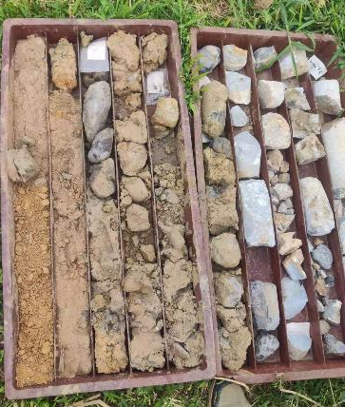
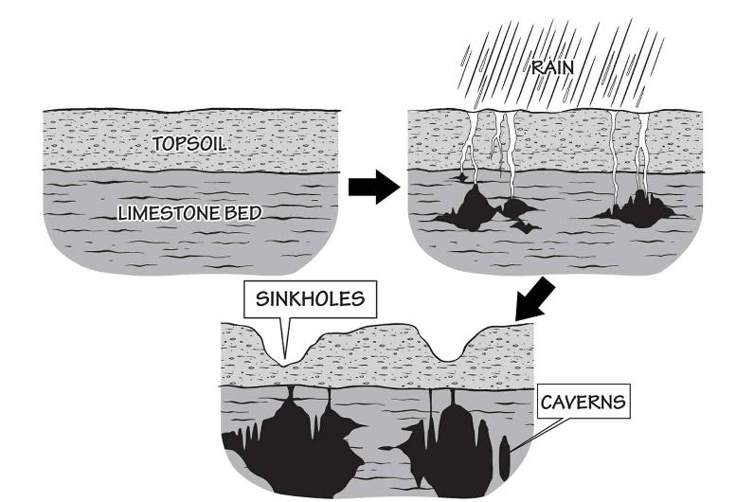
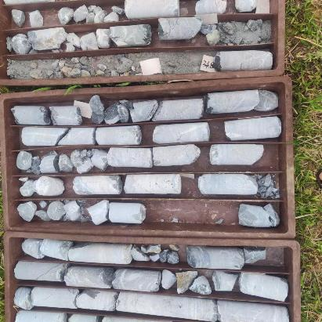
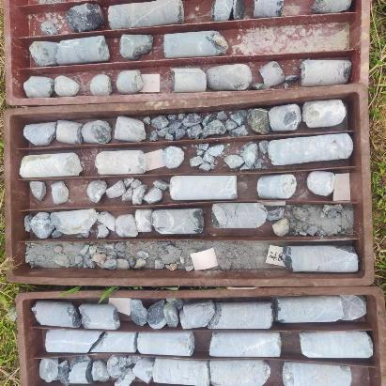
01
Introduction
SILT
SANDSTONE
Shallow
Karst cavity
Unevenly developed
Buried deeply
Deep
Karst Cave
LIMSTONE
cavity size
< 0.2m
> 24 m

Slide 5
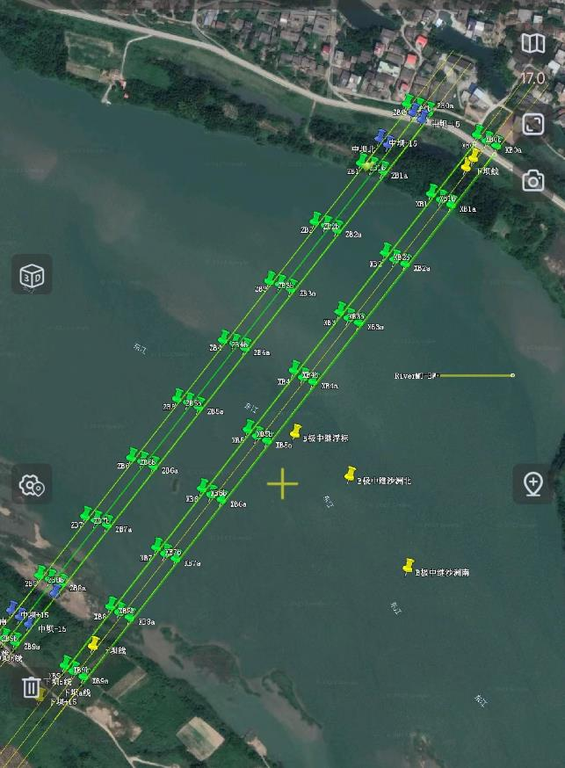

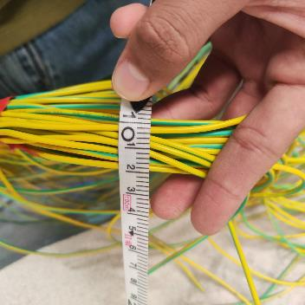
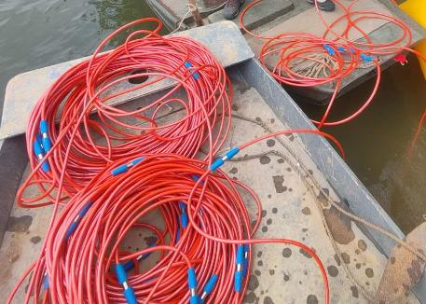
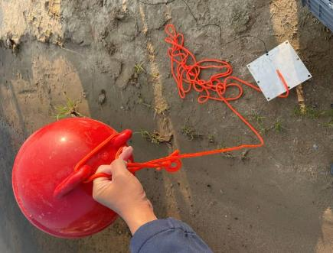

01
Introduction
Electrode
ZB
ZBb
XB
XBb
ZB
XBa
ZBa
XB
ZBb
XBb
0
XBa
ZBa
0
100
200
100
300
200
Measurement using red cable
Cable for remote electrode
400
300
500
400
Red cable length : 200m
Electrode spacing : 5m
Number of electrodes: 40
Transmit voltage: 450V
Remote electrode(B): 800m
600
500
700
600
Remote electrode
700
Survey Lines Layout
Titanium plate

Slide 6
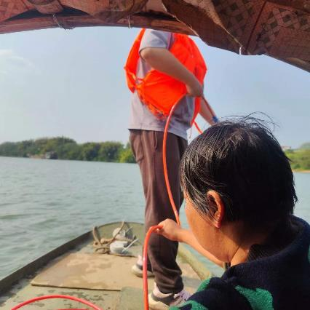
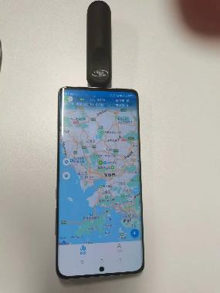
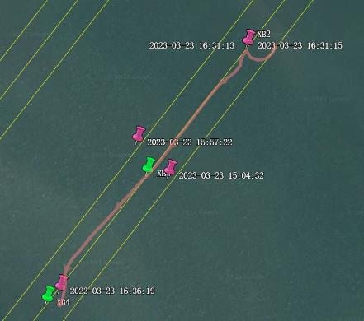
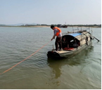
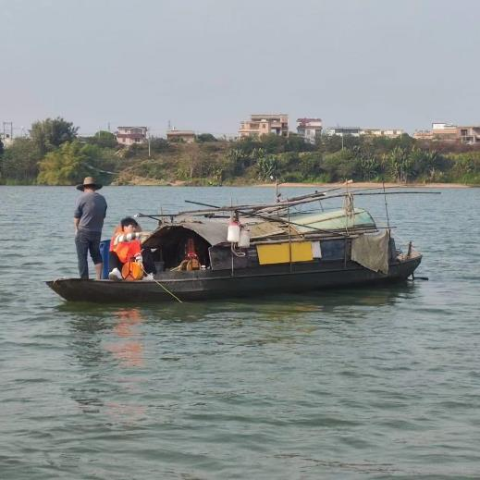
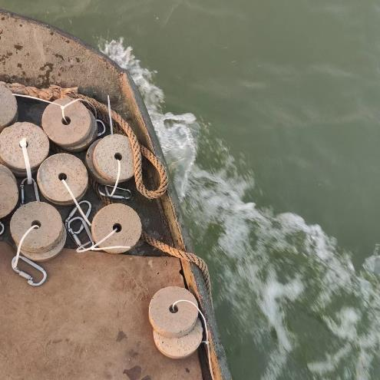

02
Surveys

Slide 7



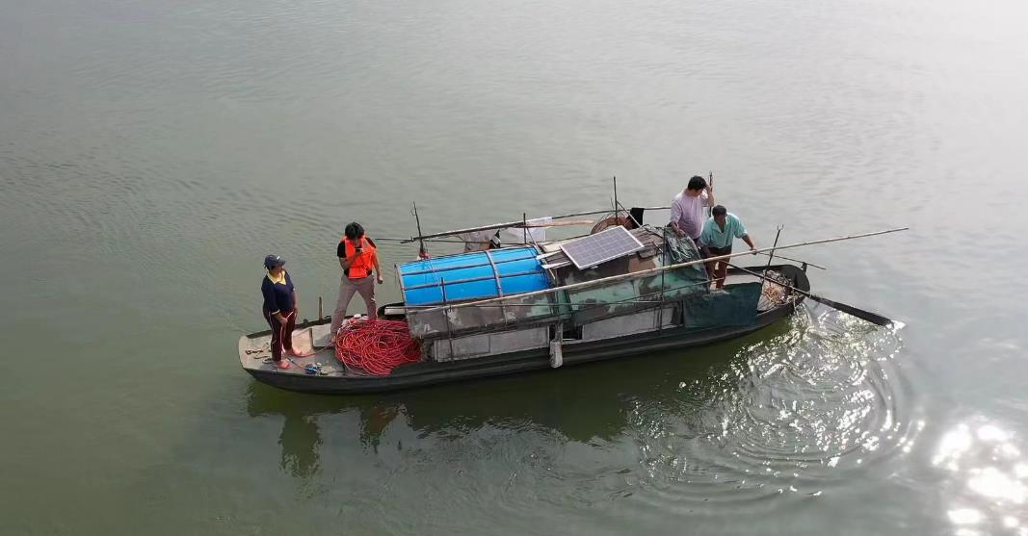

02
Surveys

Slide 8
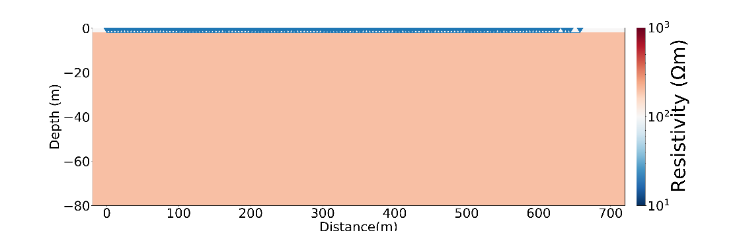
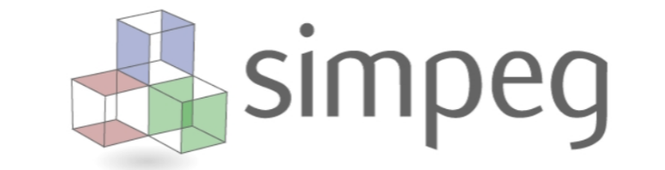

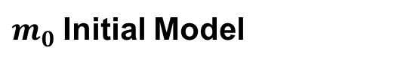
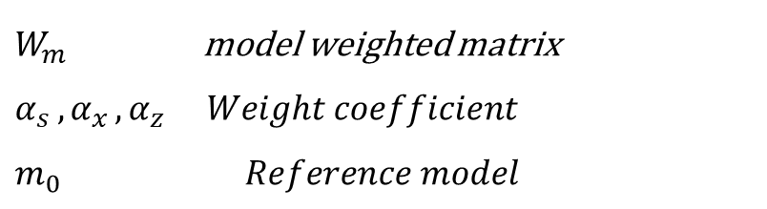
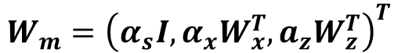
03
Methods
$$φ\left(m\right)={\left\|W_{d}\left(d_{obs}−f\left(m\right)\right)\right\|}^{2}+γ{ \left\|W_{m}\left(m−m_{0}\right)\right\|}^{2}$$
electrode
$$W_{m}={\left(α_{s}I, α_{x}W_{x}^{T}, a_{z}W_{z}^{T}\right)}^{T}$$
$W_{m}$ model weighted matrix $α_{s }{,α}_{x},α_{z }Weight coefficient$
$$m_{0} Reference model$$
$m_{0}$Initial Model
(Cockett, et al., 2015)

Slide 9
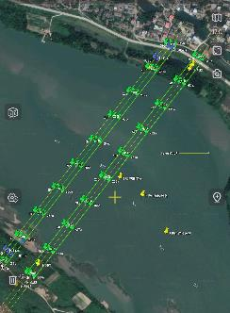
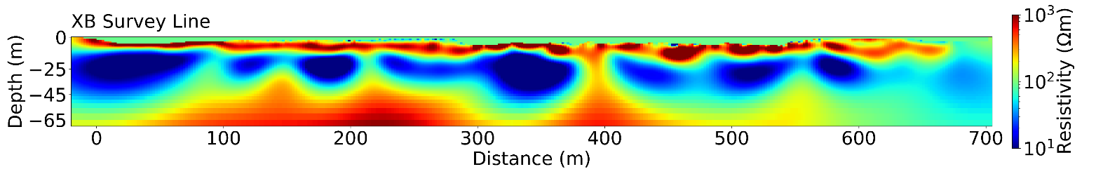
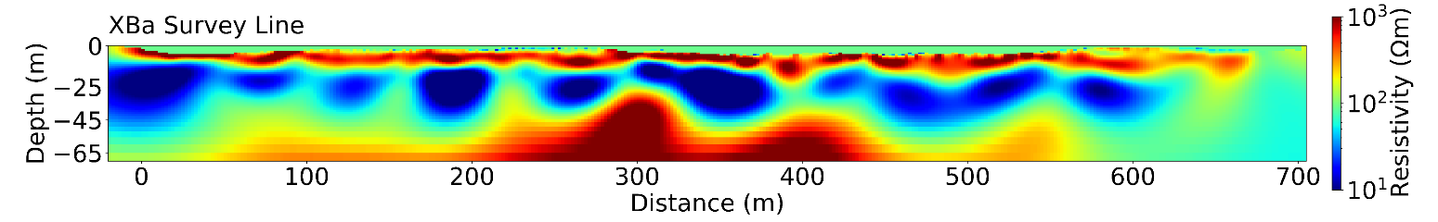
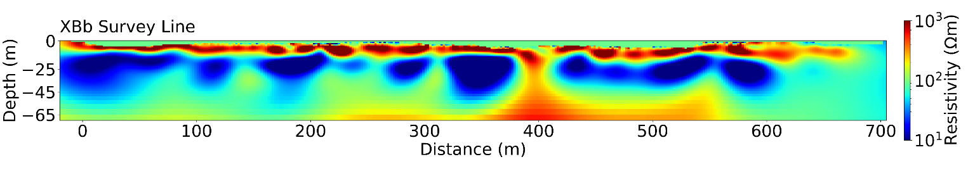
04
Results
Known cave
Speculative boundary
2D inverted results
SW
X03
CSG31
CFB04
CDZ01
CDZ02
CXS14
X07
CXS10
X09
CXS07
X10
CXS02
X20
CSG11
X34
XB area
Three-layer electrical structure
Continuity of resistivity structure
Consistency

Slide 10
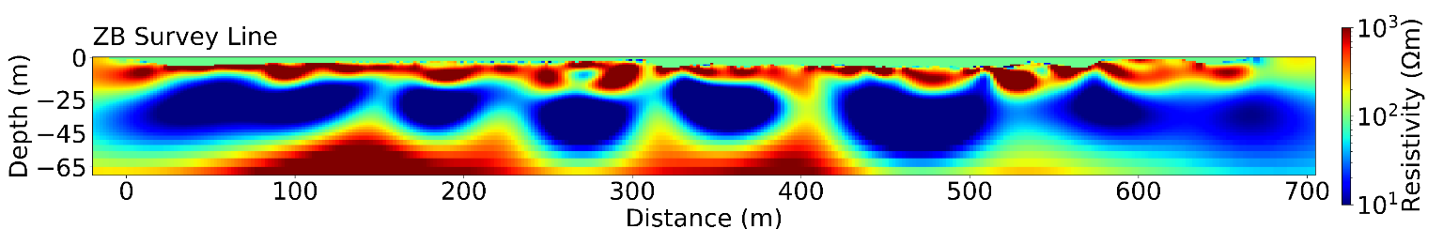
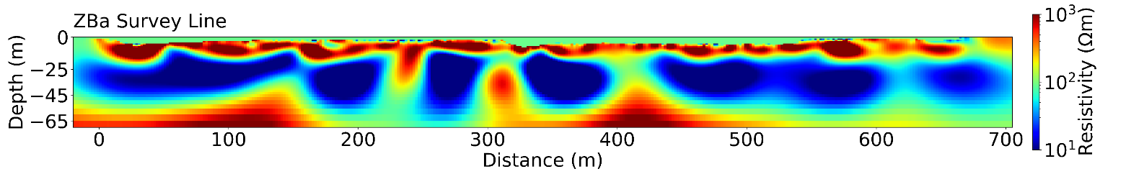
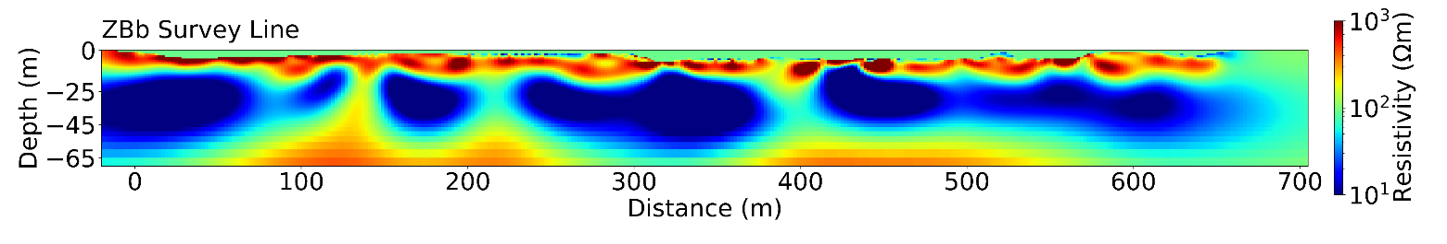
04
Results
2D inverted results
Consistency
CXS20
CXS17
CJS01
CWY15
X12
CXS16
CXS19
CWY04
CSG09
CZT19
CSG57
ZB area
Cave filling has higher water saturation, presumably

Slide 11

04
Conclusions -2D :
The electrical structure of 2D can be roughly divided into 3 layers, which is consistent with the available geologic information.
The surface silt, gravel cobblestones roughly exhibit high resistivity, the middle sandstone and shale layer exhibit relatively low resistivity, and basement limestone exhibit high resistivity.
Some of the cave's electrical structures exhibit low resistivity, inferred to be water-filled caves.
The ERT method can only give the underground electrical layering structure and shallow buried caves, and cannot find caves in the deep limestone.

Slide 12
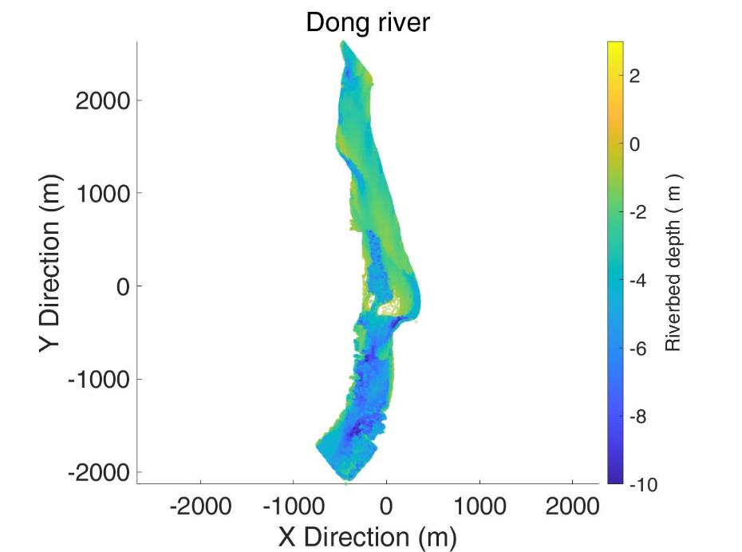
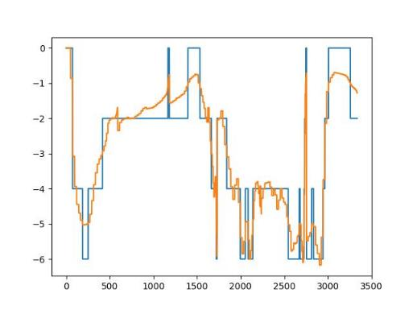
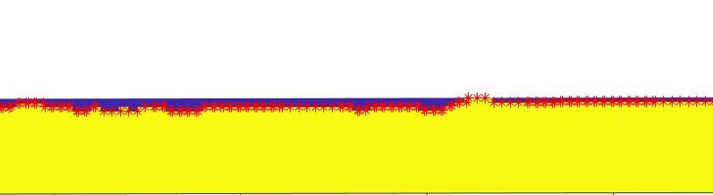
04
$W_{m}={\left(α_{s}I, α_{x}W_{x}^{T},a_{y}W_{y}^{T}a_{z}W_{z}^{T}\right)}^{T}α_{x}$ : $α_{y}$ 10 : 1
MESH:
X unit width : 5m
Y unit width : 5m
Z unit width : 2m
Measuring Cables
Topographic correction
Electrodes
Dong River
Electrode position at the interface between water and rock

Slide 13
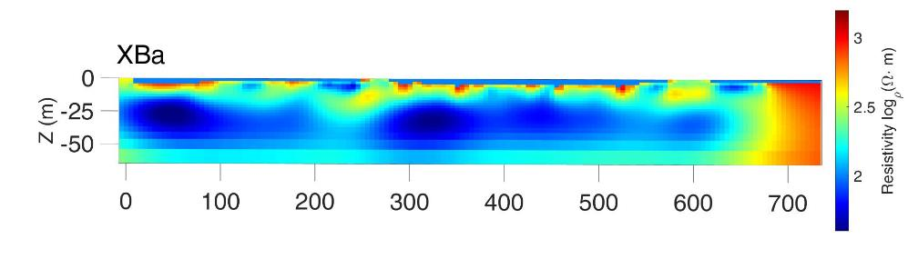
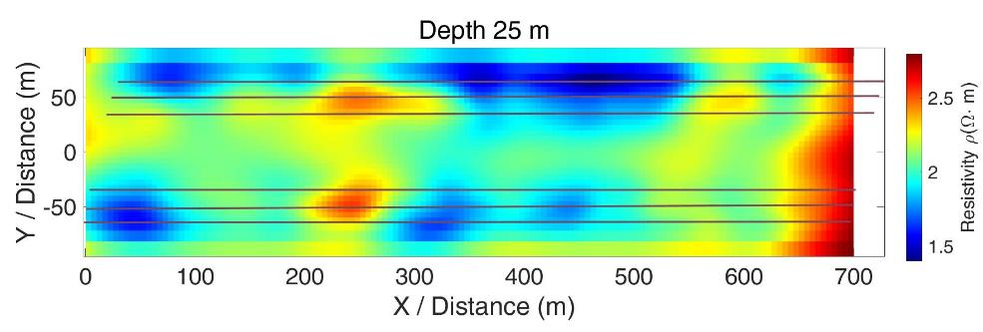
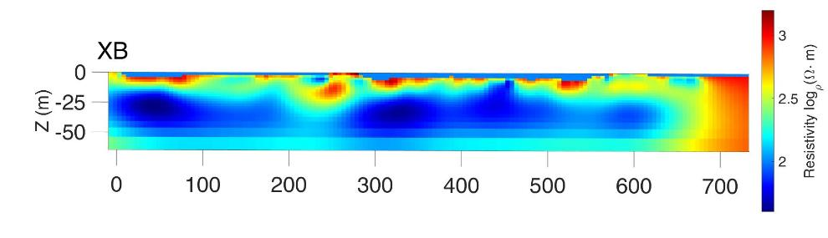
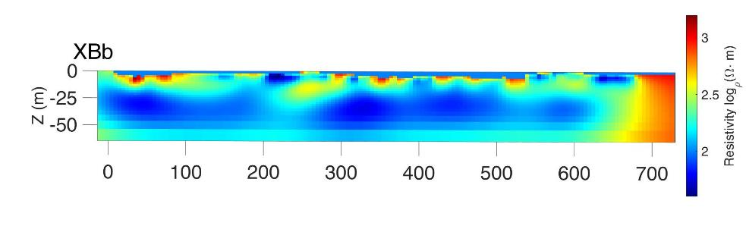
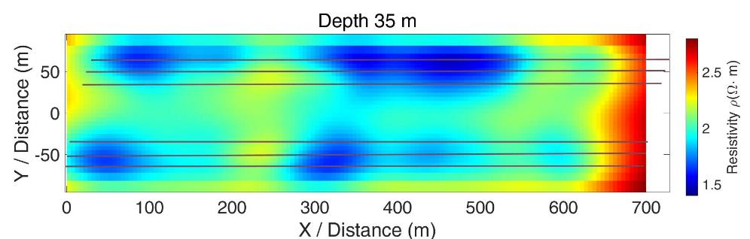
04
ZB
X (m)
XB
XB
X (m)
X (m)
Consistency in position

Slide 14
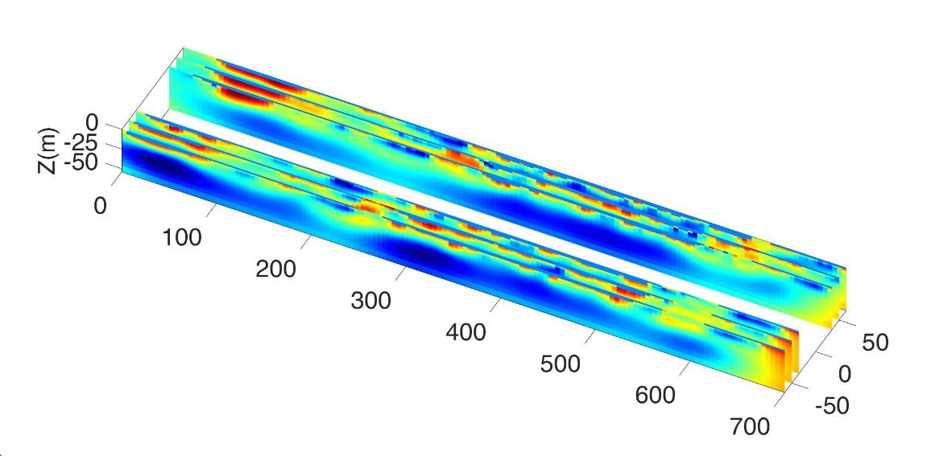
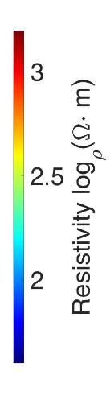
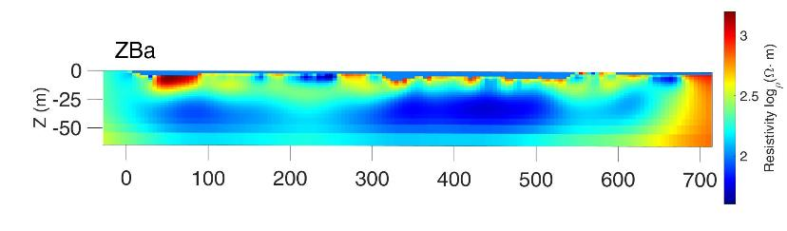
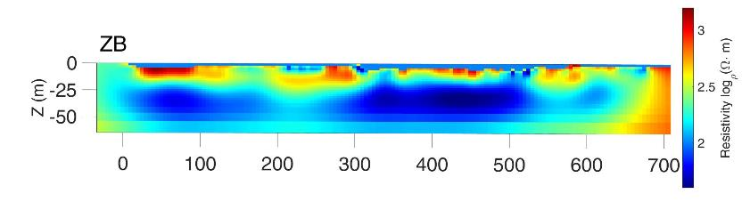
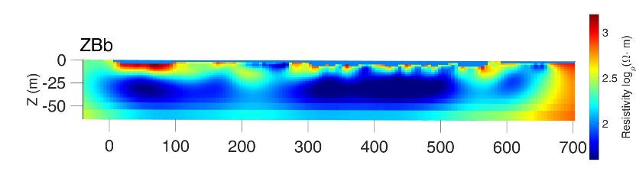
04
ZB
XB
ZBa
X (m)
X (m)
ZB
Two-layer electrical structure
The electrical structures of some parts of XB area and ZB area are continuously developed in space
ZBb
X (m)
X (m)

Slide 15
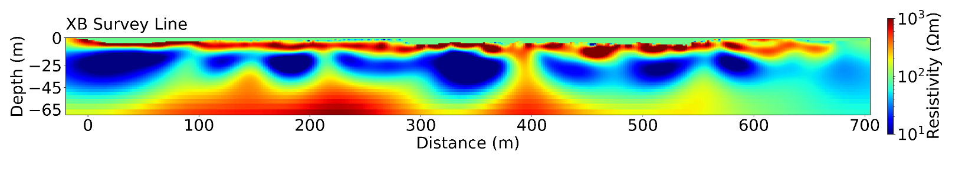
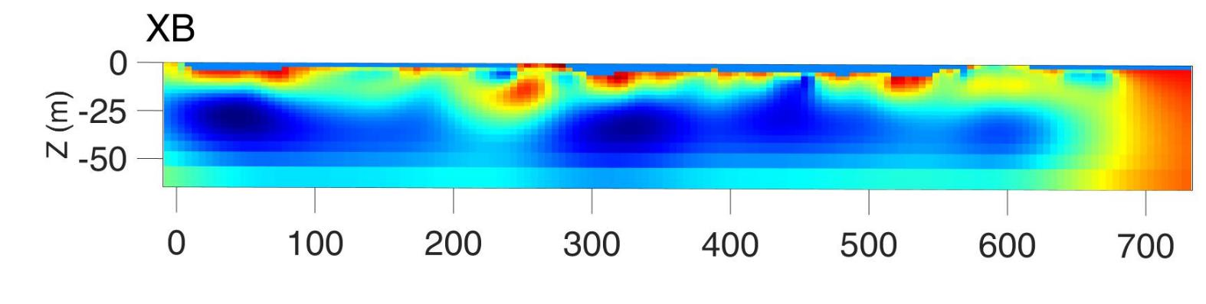
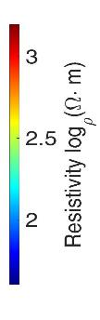
04
2D > 3D ?
2D
3D
X (m)
The results of the 2D and 3D inversions have high similarity in some localizations.
ERT is capable of effectively recognizing the interfaces of rock partings.
The electrical partitioning of 2D is in good agreement with the drilling data.

Slide 16
05
Conclusions
Conclusions:
In some cases, 2D electrical results better characterize the distribution of strata.
Spatial continuity of electrically structured anomalies of XB and ZB
Low resistivity anomalies revealed in 2D and 3D together can designate potential cavities and improve the reliability of the results.
Some of the karst exhibits low resistivity characteristics, and ERT is unable to identify cavities if they are buried too deeply.

Slide 17

THANKS！
Q & A?

